Slide 1

Industrial Training Seminar
on
“Front End Web Development”
Presented By:
Chirag Garg
University Roll No. =
IT/2nd Year-III Sem/C3
Submitted To:
Mrs Suniti Chauhan
Industrial Training Coordinator, CSE

Slide 2
Contents
Introduction / Abstract
Company / Organisation details
Certificate
Topics Covered
Overview of tools Used
Project Description
Screenshots Of Project
Conclusion
Future Scope
References

Slide 3
INTRODUCTION
.
Web development is quickly becoming one of the most attractive
and best-paid career choices in the modern world. But what is a web developer and what exactly does one do?
Table of contents
1. What is the priority of a web developer?
2. What types of web developers are there?
2.1. Front-end developer 2.2. Back-end developer 2.3. Full-stack developer
3. How to be A web developer
4. Web design vs web development
5. Popular languages for web development
5.1. Html 5.2. Css 5.3. Javascript 5.4. Php 5.5. Java
6. On your path to a web developer

Slide 4


COMPANY DETAILS
Udemy is a platform that allows instructors to build online courses on their preferred topics. Instructors can also engage and interact with users via online discussion boards.
Courses are offered across a breadth of categories, including business and entrepreneurship, academics, the arts, health and fitness, language, music, and technology. Courses on Udemy can be paid or free, depending on the instructor.
Udemy, Inc. is an American massive open online course (MOOC) provider aimed at professional adults and students. It was founded in May 2010 by Eren Bali, Gagan Biyani, and Oktay Caglar.

Slide 5
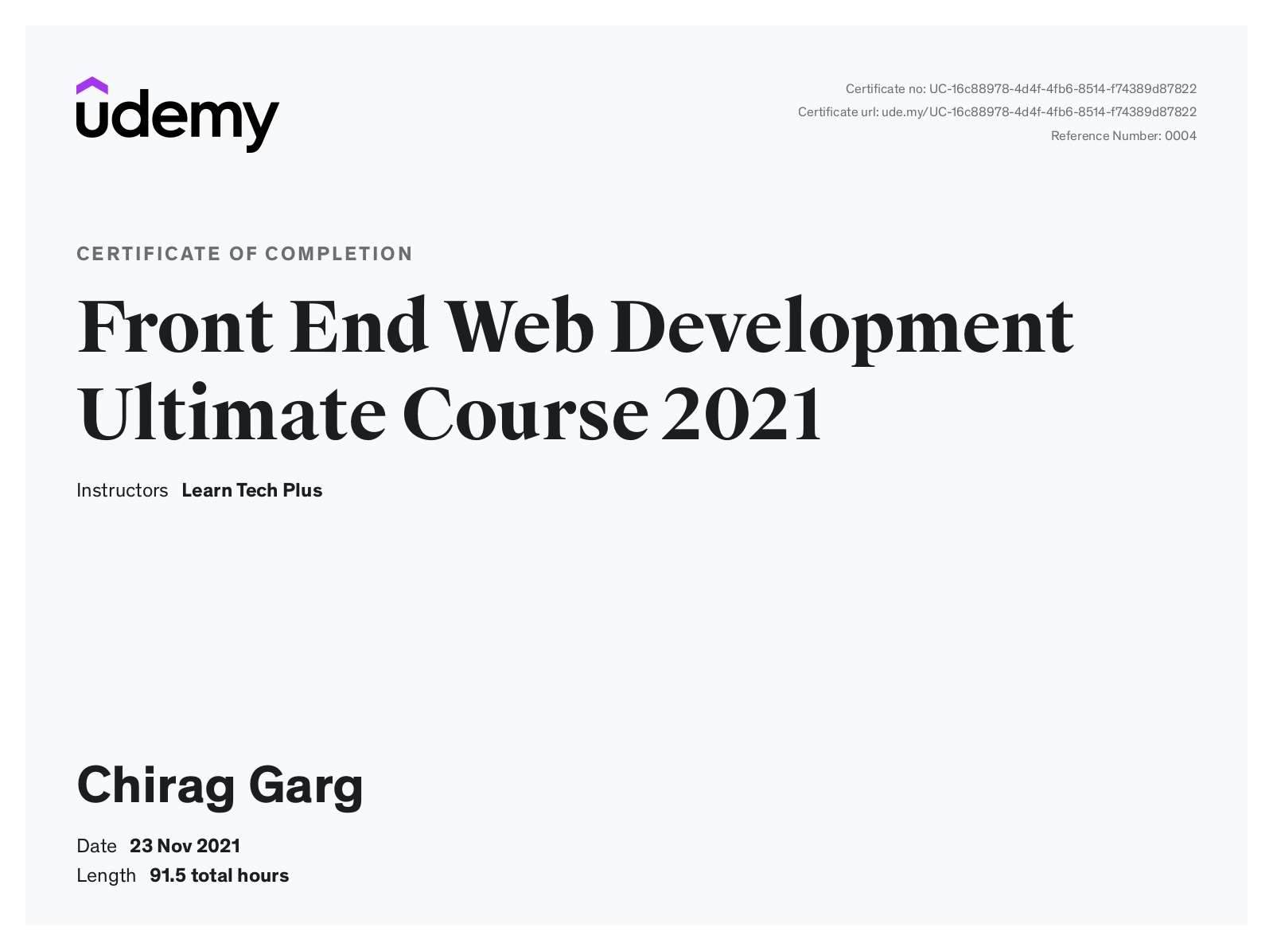
CERTIFICATE

Slide 6
TOPICS COVERED
The training consisted of
HTML
CSS
Bootstrap
JAVASCRIPT
PHP modules

Slide 7
OVERVIEW OF TOOLS USED
XAMPP Control Panel
In this project XAMPP Control Panel is used to host a
Local server and to store data in MYSQL Database
Easily.
Visual Studio Code
For Executing Code easily & Display Output on
Webpage. For this Live Server Extension is used
for reliability.

Slide 8
PROJECT DESCRIPTION
In this Project I made a simple website of Travel and Tourism. It includes a Login Page, Home Page , Index Page , Signup Page , Contact Us Page,About us Page, Cart Page, Settings Page using HTML , CSS, BOOTSTRAP , MYSQL AND PHP.
I also use MYSQL Database to Store Customer and Products Data
Like Customer-Name, Address, Contact no., Email , Password And also Products Data like ITEM NO. , PRICE.
Screenshots of all pages and some codes also of Database are on following pages.

Slide 9
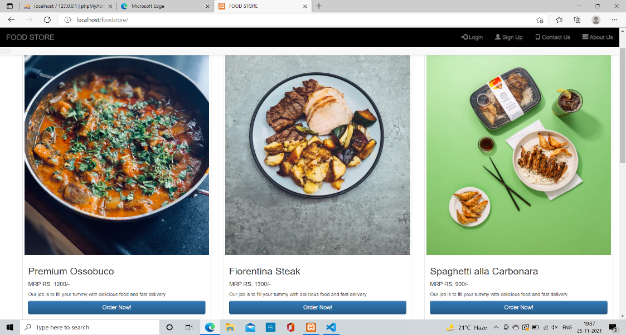
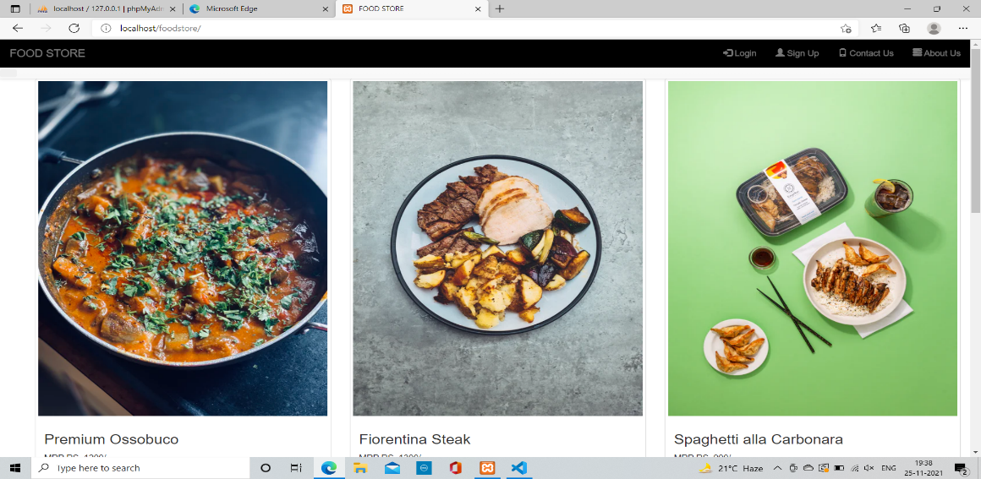
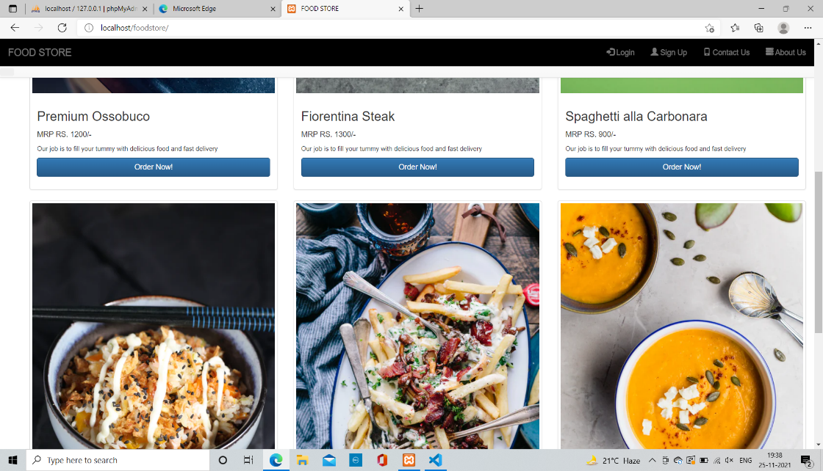
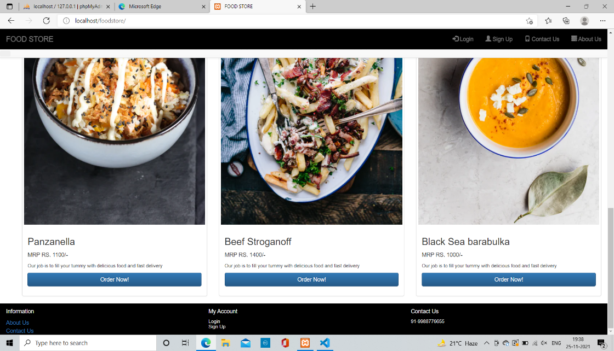
Index page of website foodstore

Slide 10
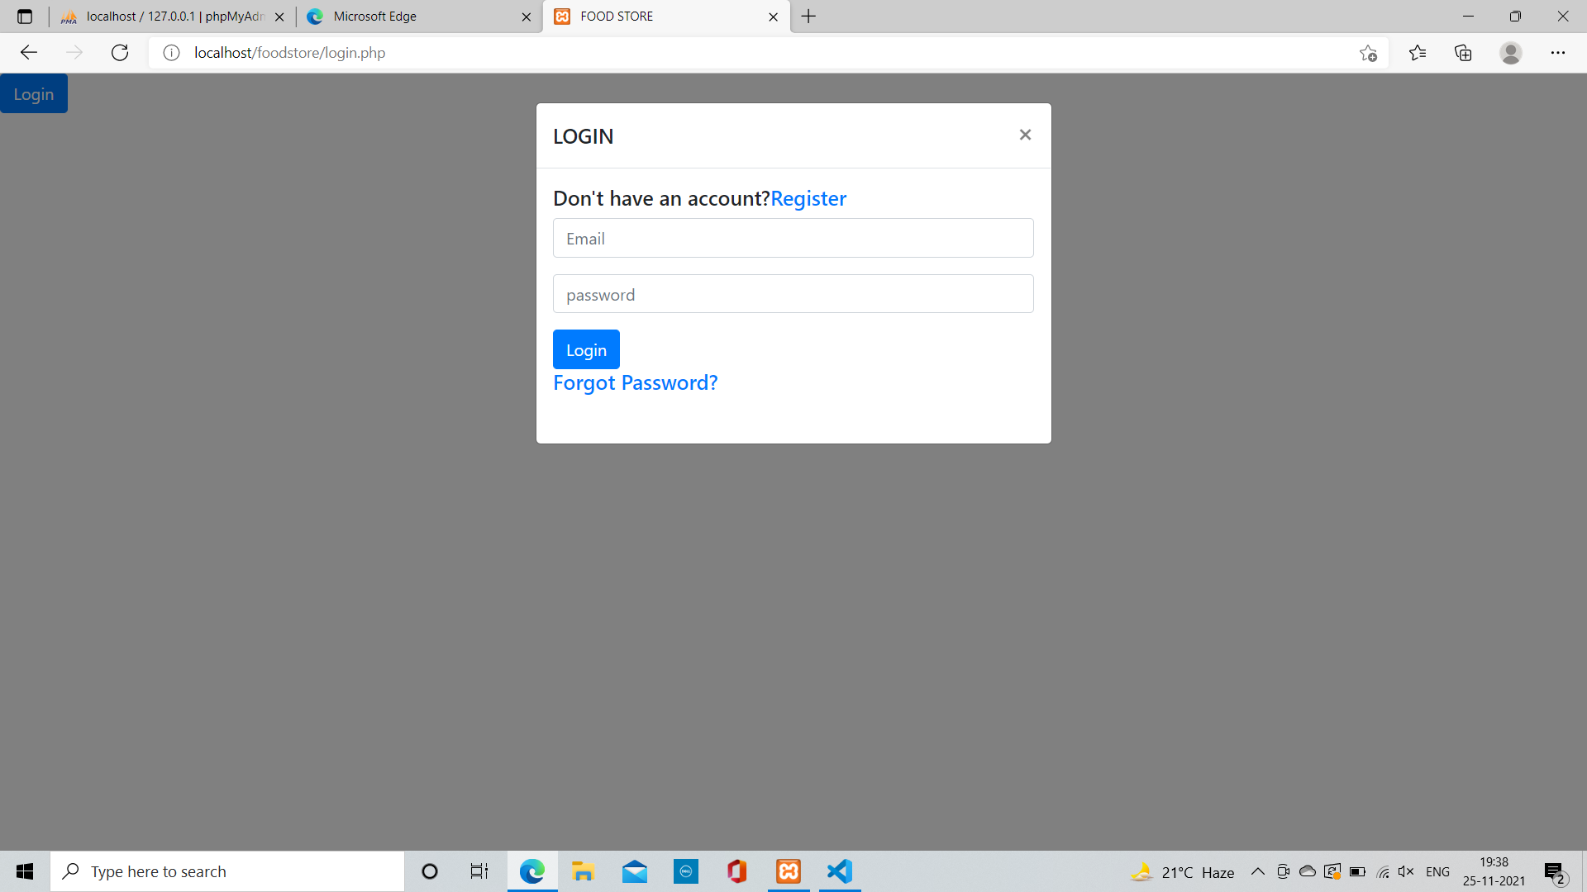
Login pop-up page of website foodstore

Slide 11
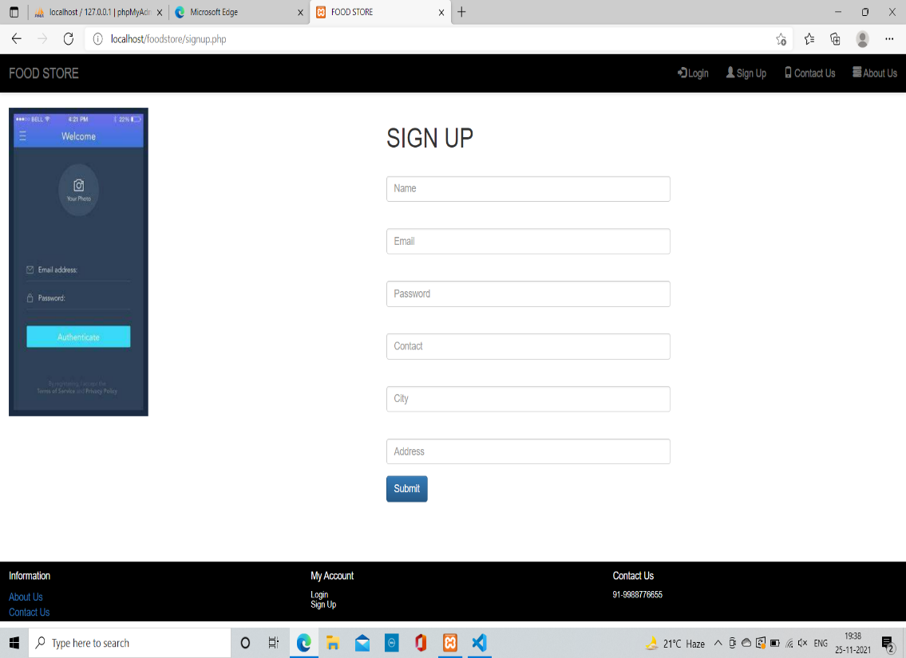
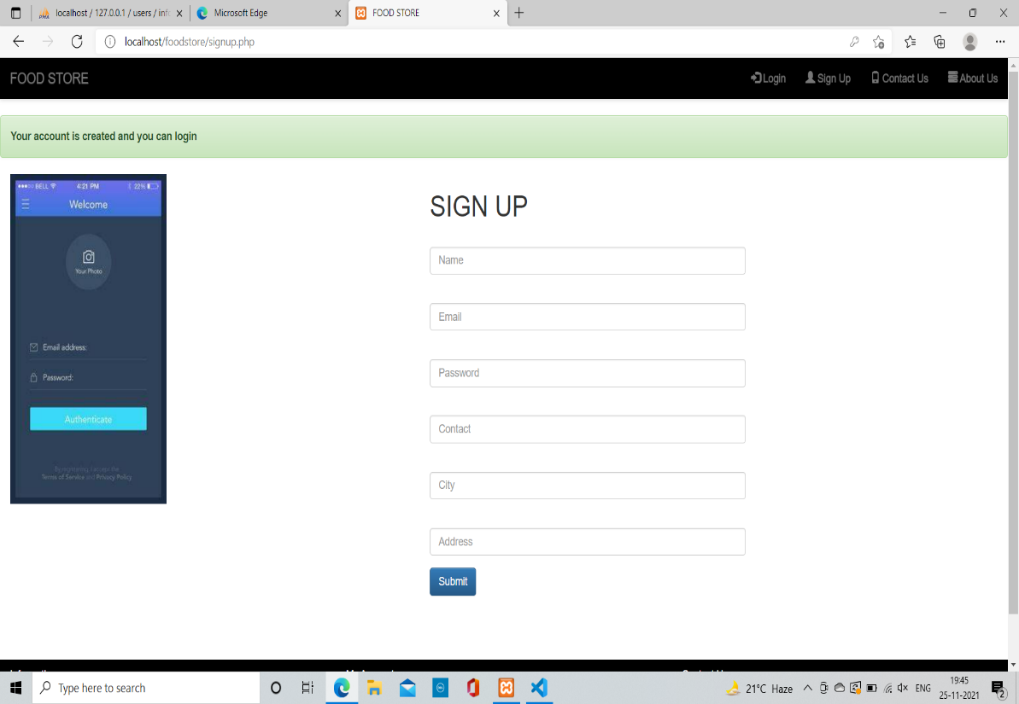
Sign up page of website foodstore

Slide 12
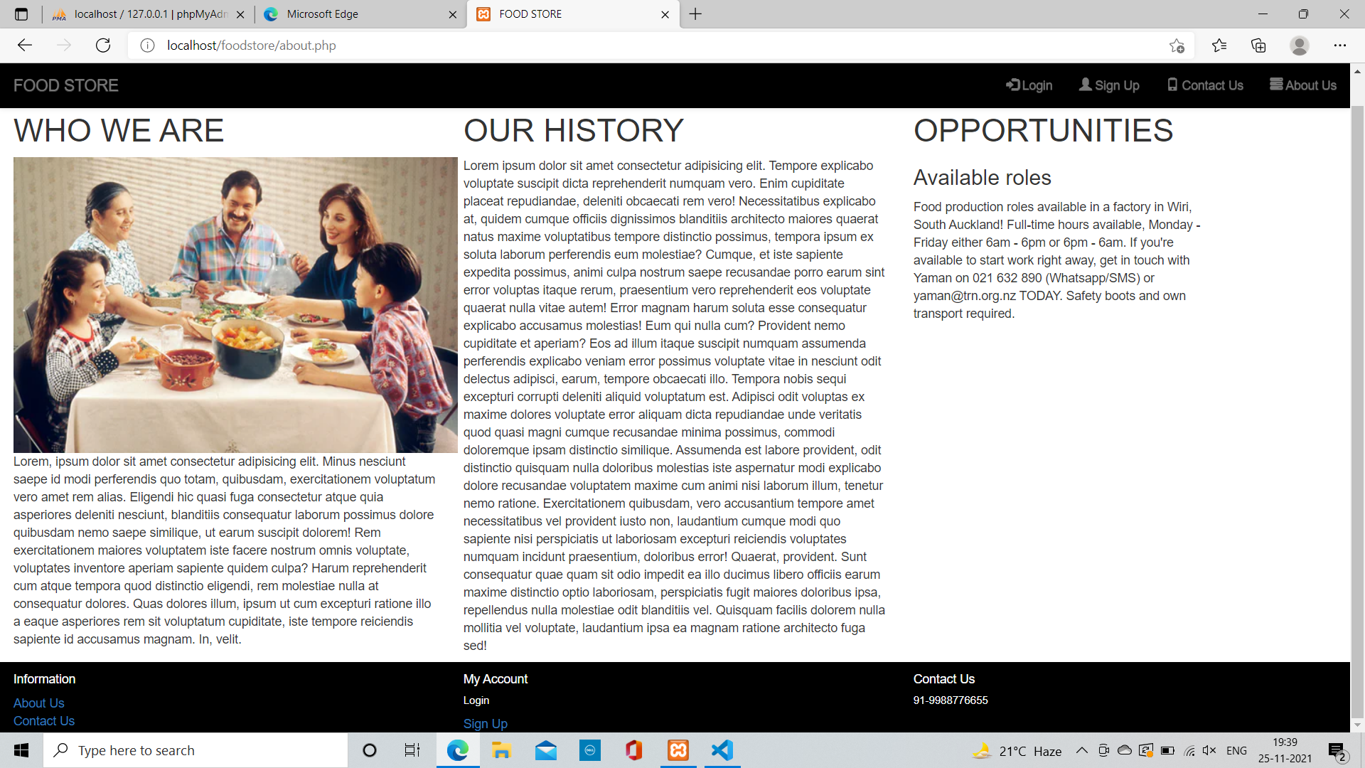
.
About us page of website foodstore

Slide 13
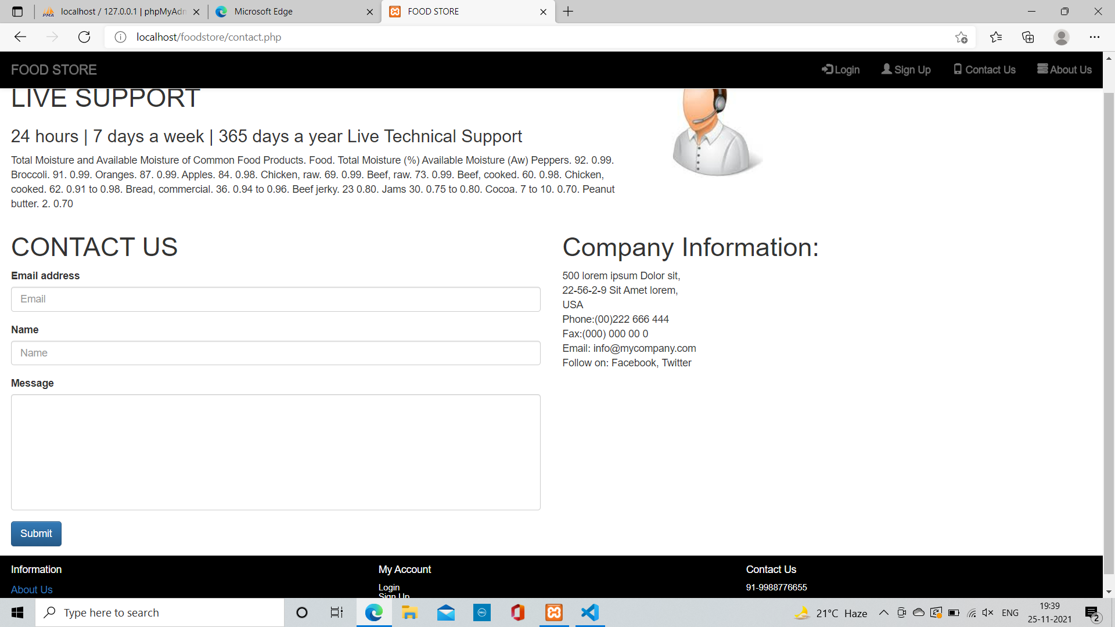
.
Contact us page of website foodstore

Slide 14

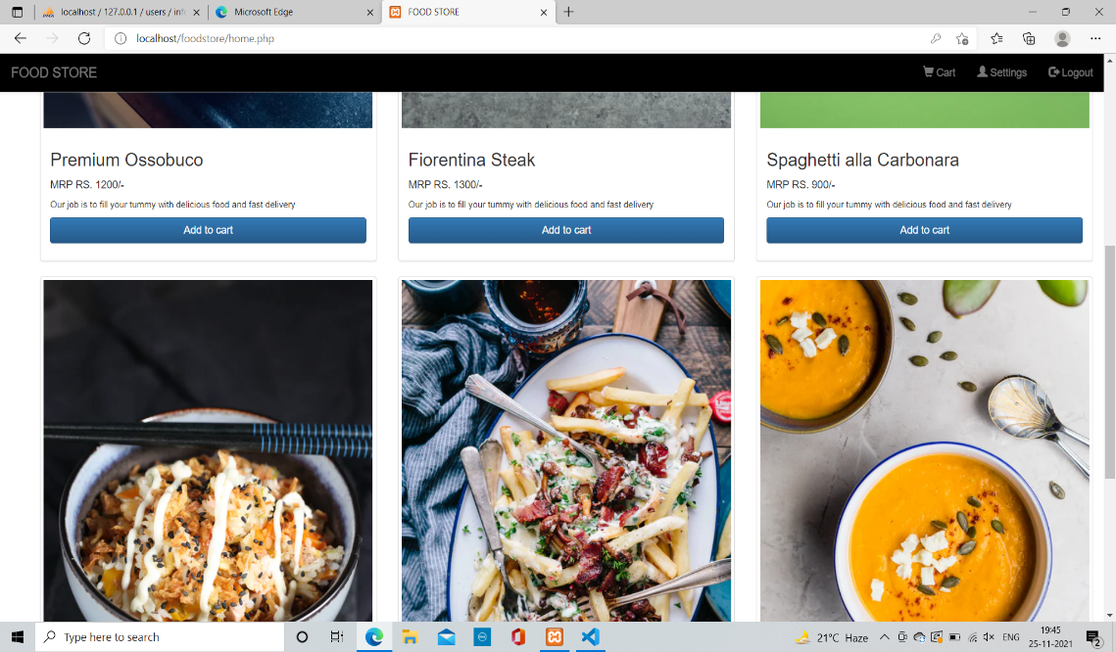
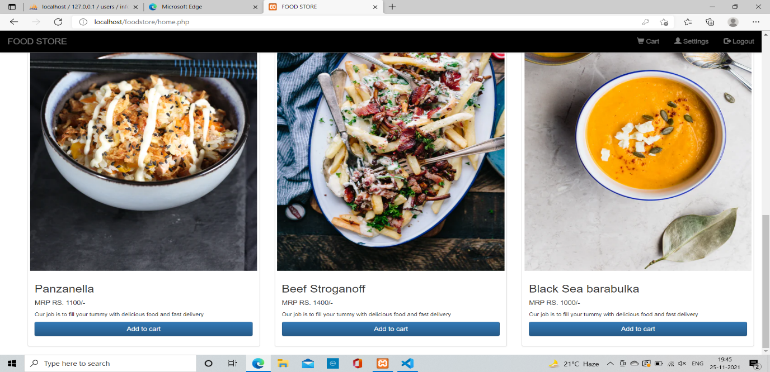
.
Home page of website foodstore

Slide 15
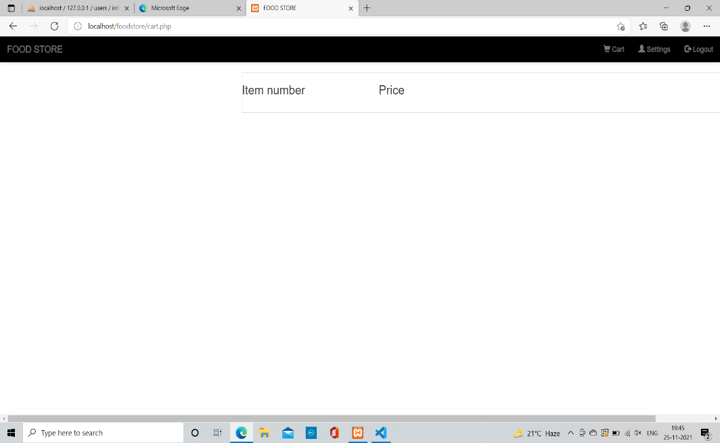
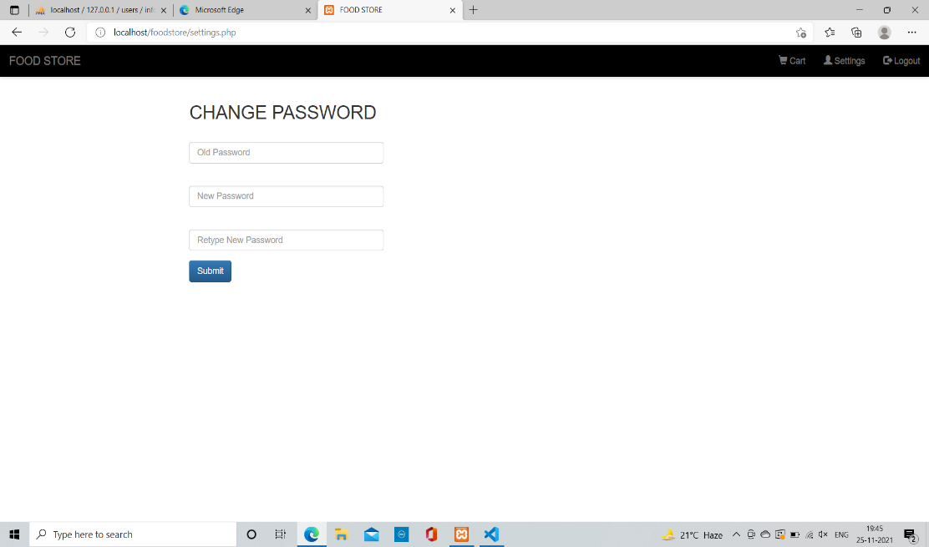
.
Cart page & settings page of website
CART PAGE SETTINGS PAGE

Slide 16
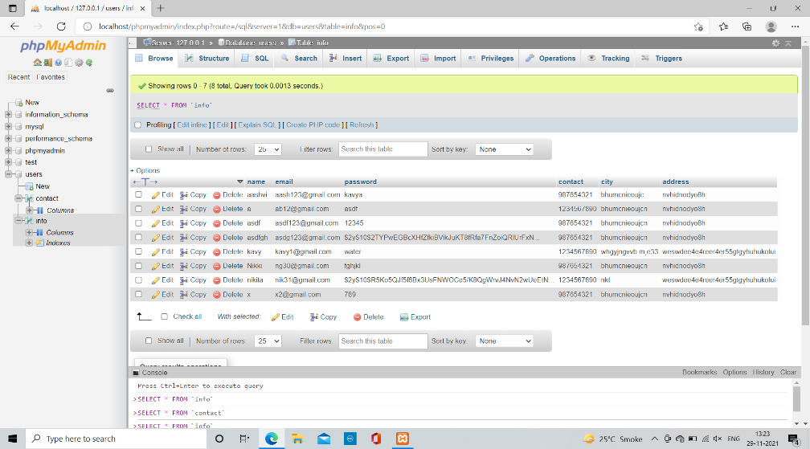
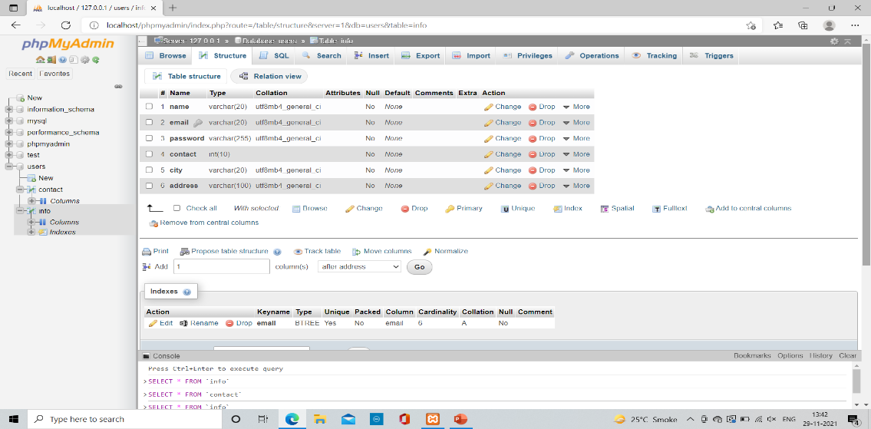
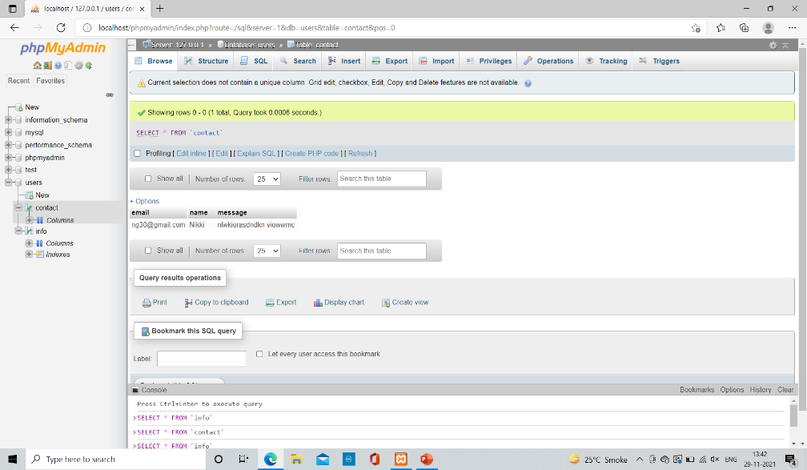
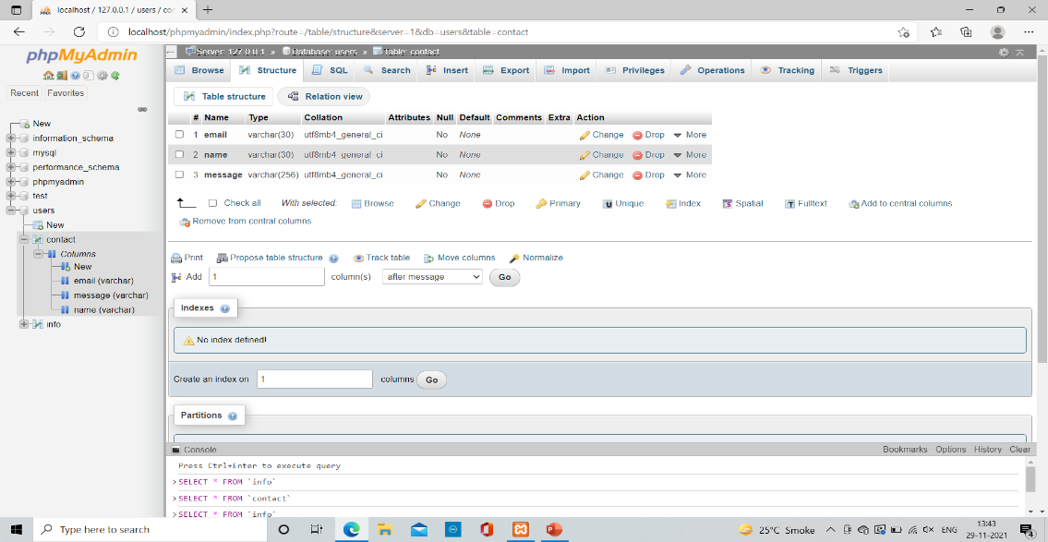
Mysql database using xampp control panel

Slide 17
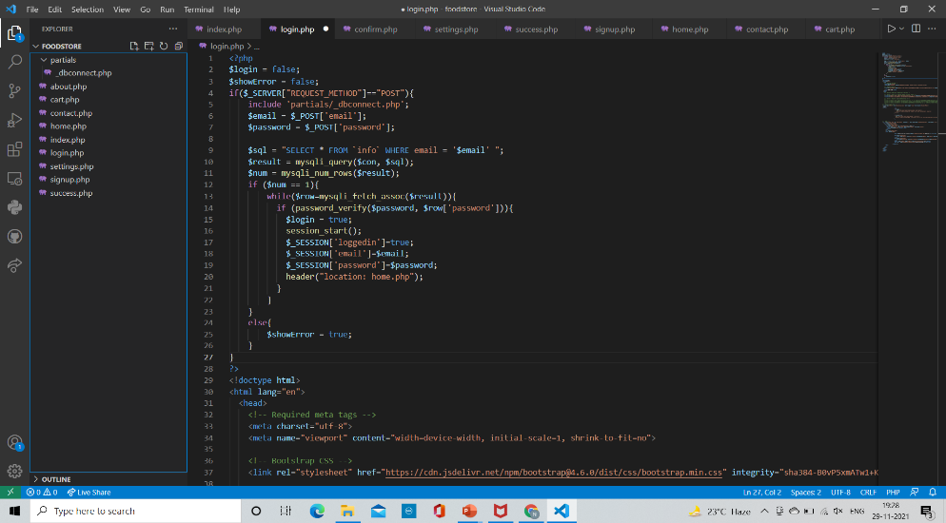
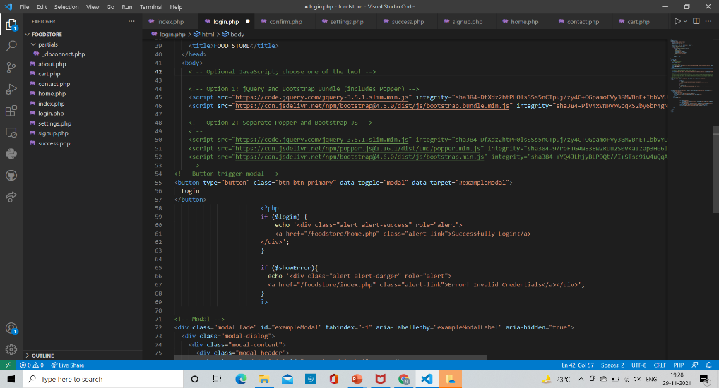
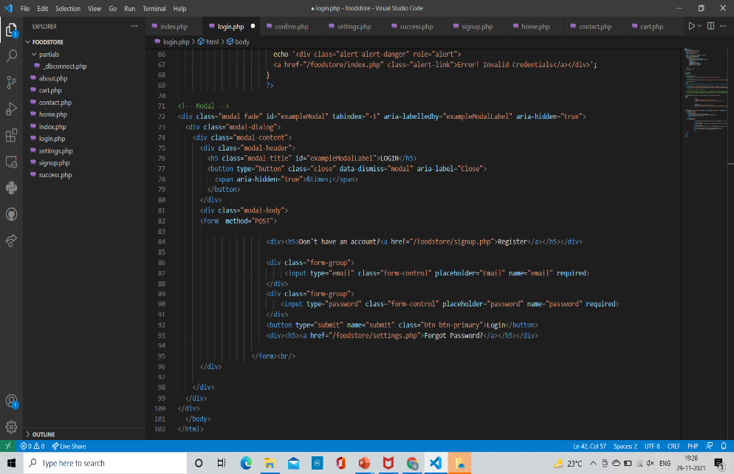
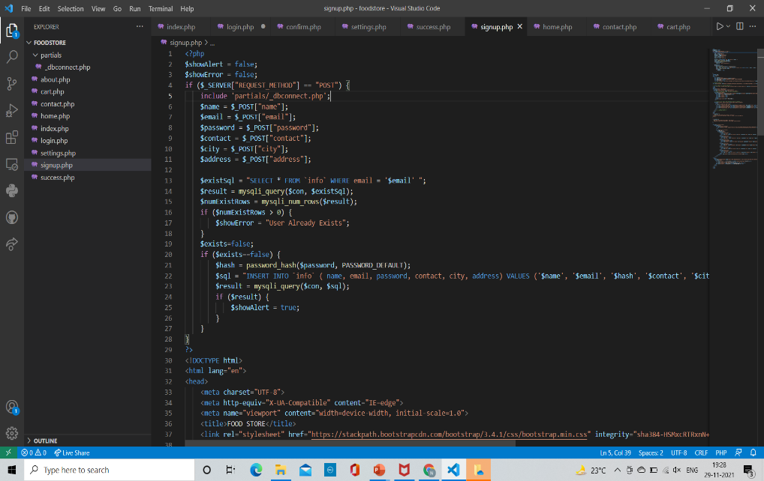
.
Some Screenshots of Codes

Slide 18
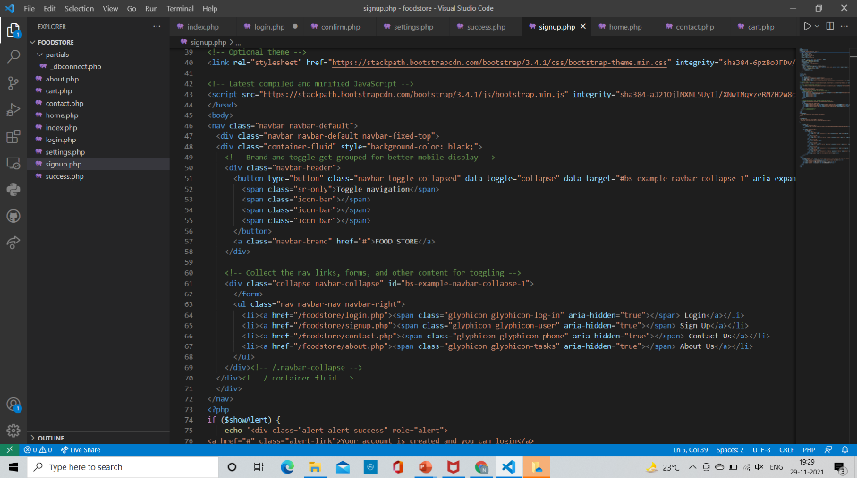
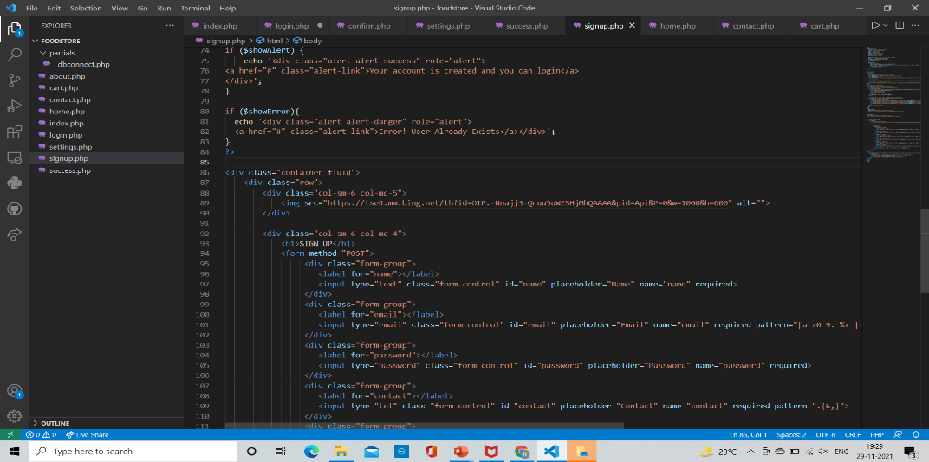
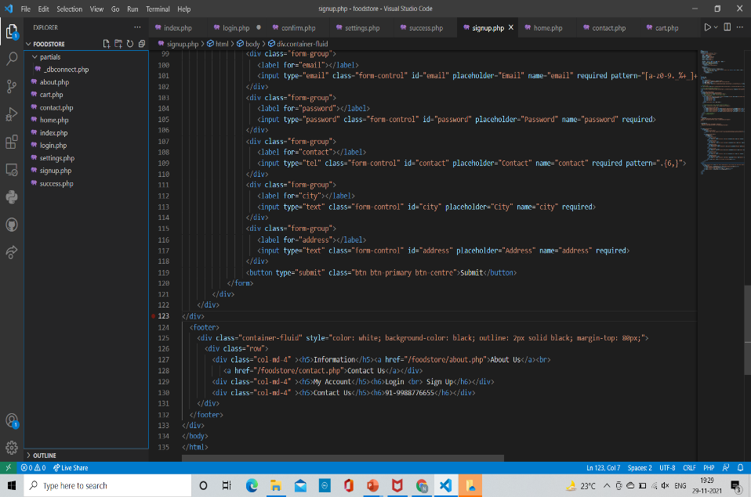
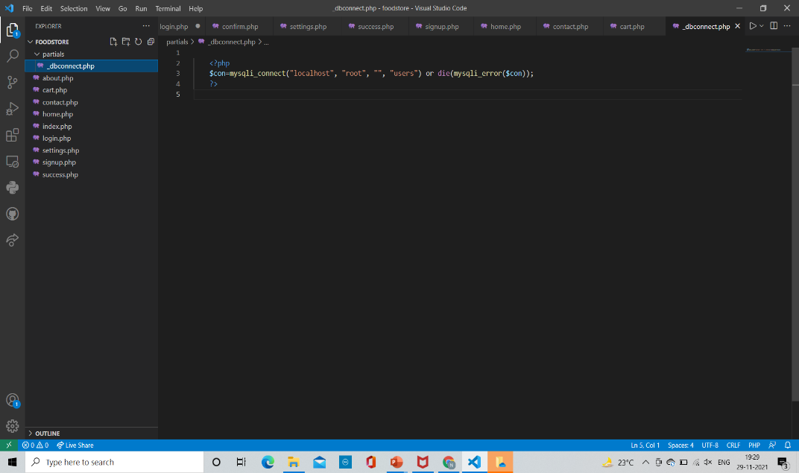
.
Some Screenshots of Codes

Slide 19
CONCLUSION
I have completed this course in 6 weeks. I have learned a lot from this course and based on which I have made a website.
During this course I found that designing a website is
very interesting and easy. Anyone can learn this
without high knowledge of hard coding. There are
many frameworks available like bootstrap which gives built in Templates.

Slide 20
FUTURE SCOPE
There are many reasons building a website requires that we obtain the right tools and resources.
Standardization is one factor. When we use the right tools, we are assured that our pages would be standard and acceptable to every visitor.
By using standard resources and tools, our visitors are able to view our web pages no matter what browser they use. Our pages would load faster and we would also be able to maintain the pages we have created with ease.

Slide 21
.
Using the right resources for our web design jobs will make our websites contemporary. They can easily integrate into current technologies and software. Our users would derive added value from our websites and contribute to its growth.
The right resources also make it easy for surfers to use our site. The standard tools used for creating the website will ensure that things such as navigation, menus and layout conform to current practices with which every web user is familiar with.
Our pages become attractive if we use the right tools. They can display correctly in the browser and your visitors would be glad to visit again because you appealed to then.

Slide 22
.
Search engines would index your website if the pages conform to their rules. Standard tools like blogs will produce pages that understand how search engines index pages so you will have the added advantage of increase visibility of the web.
Web tools make your web design job easy. Coding can take away a lot of time and produce fatal errors if you are not proficient. GUI interfaces take away all the incidences of errors and labor, and give you something manageable.
Speed of implementation comes with the right tools. You can create a website and launch it in an hour with the right resources. You save on time, effort and never miss important deadlines.

Slide 23
.
Now that you are equipped with the right knowledge you can go about your web design with the assurance that you are going to produce something appealing and acceptable to most browsers.

Slide 24
.
REFERENCES
Internshala
HTML and CSS: Design and build websites, by Jon Duckett
Php-and-MYSQL-for-dynamic-web-sites
Php-objects-patterns-and-practice

Slide 26


